Slide 1
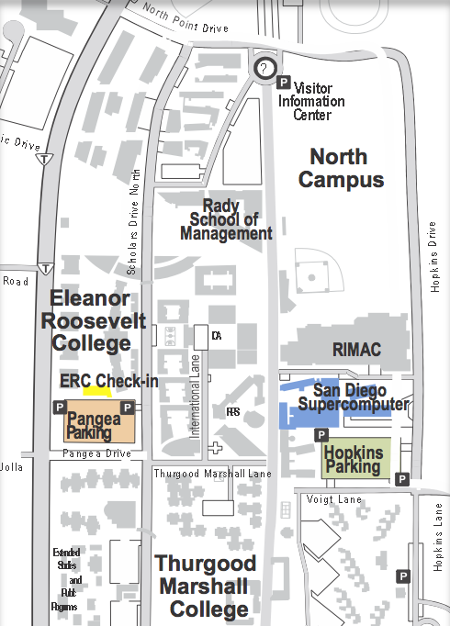
G
e
n
e
s
e
e
A
v
e
n
u
e
e
n
a
L
t
n
i
o
?
T
o
r
r
e
y
P
i
n
e
s
S
c
e
n
i
c
D
r
i
v
e
e
v
i
r
D
s
n
i
k
p
o
H
G
e
n
e
s
e
e
A
v
e
n
V
o
i
g
t
D
u
r
i
v
e
e
v
e
i
V
o
i
g
t
D
r
i
v
e
r
D
t
n
i
o
P
s
u
p
m
a
C
M
a
t
t
h
e
w
s
L
a
n
e
d
a
o
R
d
s
a
e
o
n
EMERGENCY
R
i
s
P
t
y
n
e
e
r
g
r
e
o
T
e
R
h
t
v
r
M
i
o
y
r
N
e
r
D
s
D
r
n
i
v
e
a
m
l
r
i
a
G
v
e
l
r
i
o
D
h
t
e
r
c
e
n
S
M
e
d
i
c
a
l
C
M
i
r
a
m
a
r
S
t
r
e
e
t
L
a
n
e
e
r
v
e
i
s
l
r
O
D
a
l
h
l
t
o
u
J
o
a
S
?
L
e
a
v
l
i
l
r
i
s
D
V
S
c
h
o
l
a
r
L
a
J
o
l
l
a
V
i
l
l
a
g
e
D
r
i
v
e
e
v
i
r
D
a
l
l
o
J
a
L
a
l
l
i
V

Slide 2
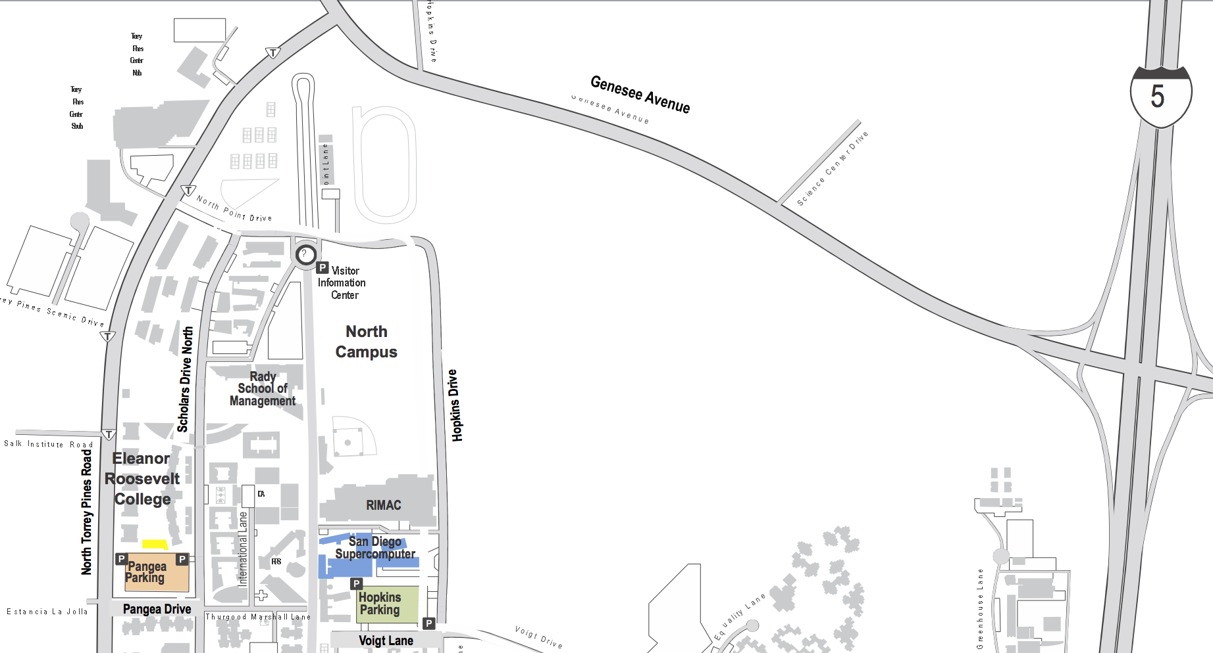

SDSC Summer Institute
Driving Directions
To UC San Diego San Diego Supercomputer Center (SDSC) and HOPKINS Parking Structure
from Interstate 5 Freeway
Take I-5 toward La Jolla
Take Genesee Avenue Exit
(Left Turn from 5 South / Right Turn from 5 North)
At the top of the hill turn Left on North Torrey Pines Rd.
Left on North Point Drive
Followed the road into Hopkins Drive
SDSC and Hopkins Parking Structure is on Right
To UC San Diego Eleanor Roosevelt College (ERC) and PANGEA Parking Structure from Interstate 5 Freeway
Take I-5 toward La Jolla
Take Genesee Avenue Exit
(Left Turn from 5 South / Right Turn from 5 North)
At the top of the hill turn Left on North Torrey Pines Rd.
Left on Pangea Drive
Left on Scholars Drive North
ERC and Pangea Parking Structure on Left
Eleanor Roosevelt College (ERC) office number: 858.534.1142
ERC Check-in

